Slide 1
Distributional Aspects of Aging in America: Insights from National Transfer Accounts
August 5, 2020 NTA13
Session on Distributional NTA Ronald Lee, Gretchen Donehower, Andrew Mason, Michael Abrigo

Slide 2
Most estimates just done yesterday, here show early results
Estimates are thanks to Gretchen and Michael.
Various problems and distractions have delayed our work, so early work in progress – but still interesting!
Results are annual for 1988-2018.
Here we compare 1988 to 2018.
Other years need more adjustments.
All estimates include college students, prison inmates and people in nursing homes (institutionalized population). New. Lots of work.
Start with some for 2006-2018 from May workshop.
Then new results.

Slide 3
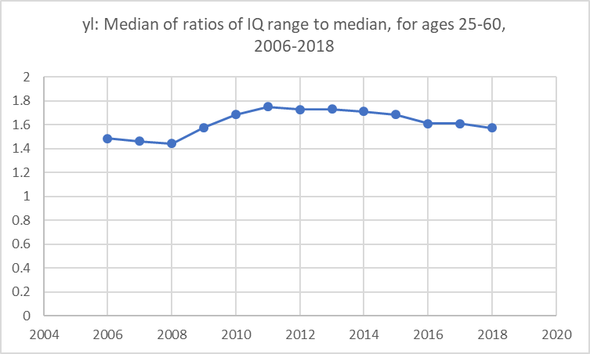
Labor income inequality over time (median of Inter-Quartile Range/Median for ages 25-60)
Inequality is flat 2006 to 2008 (March).
Inequality rises rapidly after Recession hits in July of 2008, rising until 2011.
Then very slowly declining but still greater than pre-recession.
Great recession

Slide 4
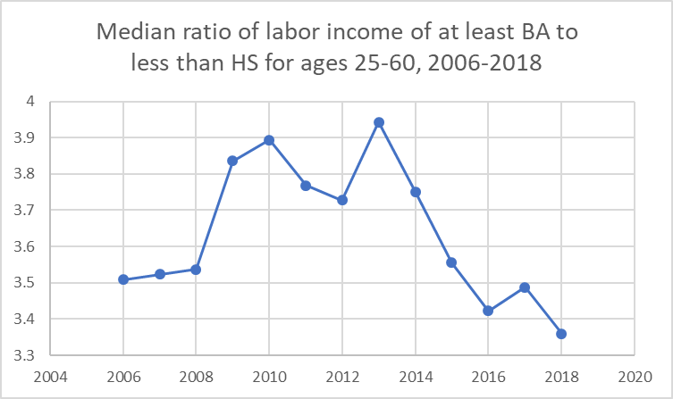
Ratio of labor income for college degree to less than high school
The advantage of college degree relative to less than high school jumped when recession hit.
Stayed high for years, but then plunged as labor market got tight and unemployment dropped to 5.6% in 2014.
Now low education workers are doing better than before recession.
Great recession

Slide 5
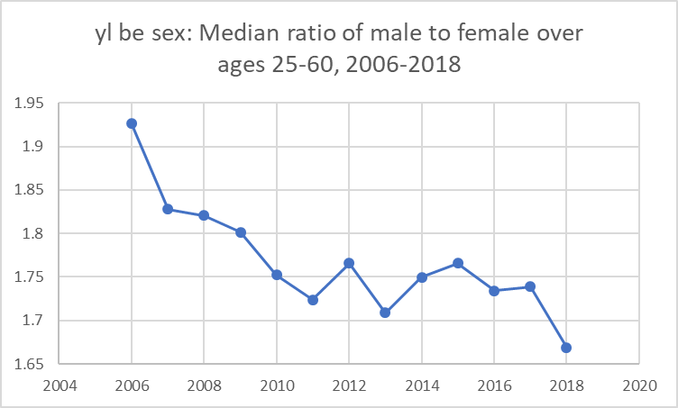
Ratio of male to female labor income dropped throughout
Lower in 2018 than in 2006
Seems unrelated to recession
Still two thirds higher for men.

Slide 6
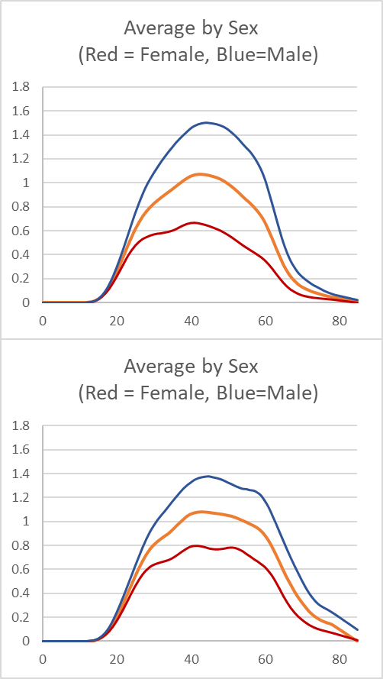
Difference in labor income by sex between 1988 and 2018 declined
Labor Inc by Sex
Ratio at age 42 declined from 2.24 to 1.71.
1988
2018

Slide 7
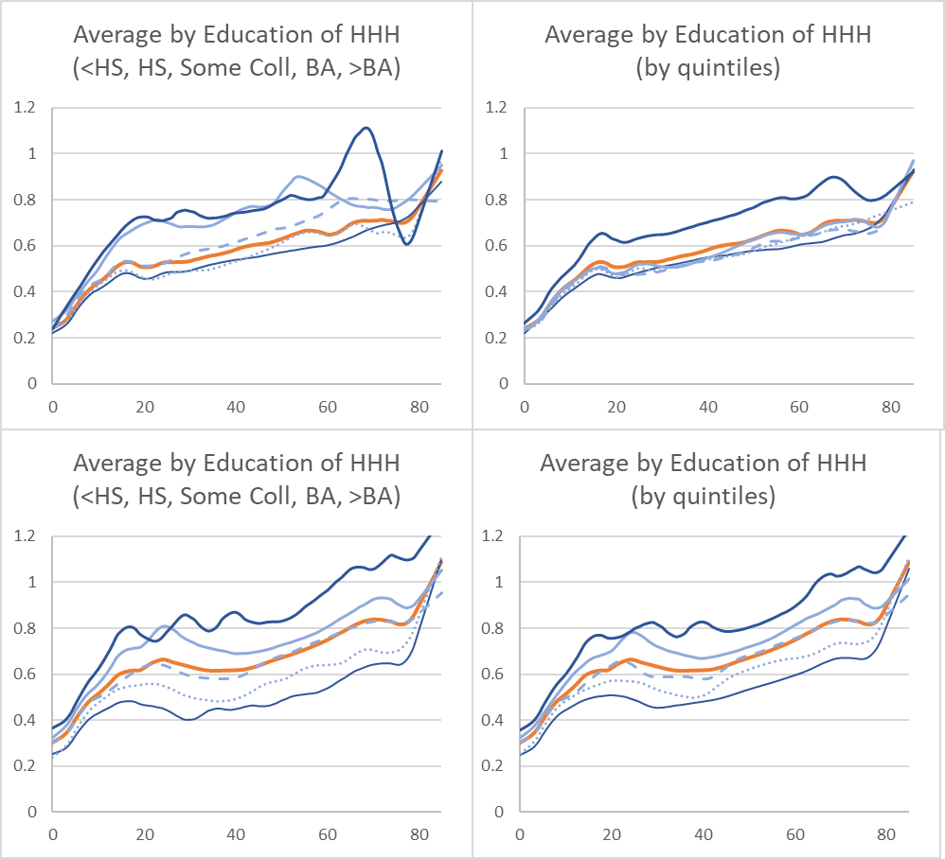
Consumption by education
Consumption by educ & educ quintile
Over time, pop with low education shrinks and with high grows, so selectivity issues in comparing.
Left hand panels shows cons by educ level.
Right hand side shows by educ quintile – e.g. bottom 20% of educ attainment instead of <HS.
Avoids selectivity issues
Note diffs are smaller for educ quintiles.
Also note that by either measure, inequality was greater in 2018 than in 1988.
1988
2018

Slide 8
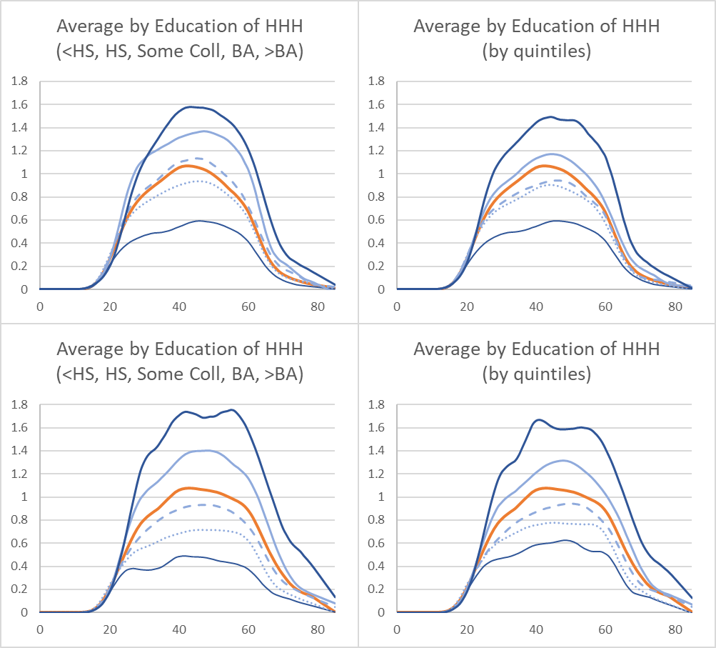
Labor Inc by education
Labor Inc by educ & educ quintile
1988
As with consumption, labor income inequality is:
smaller for educ quintiles.
greater in 2018 than in 1988 by both measures (compare lowest lines in 2018).
2018

Slide 9
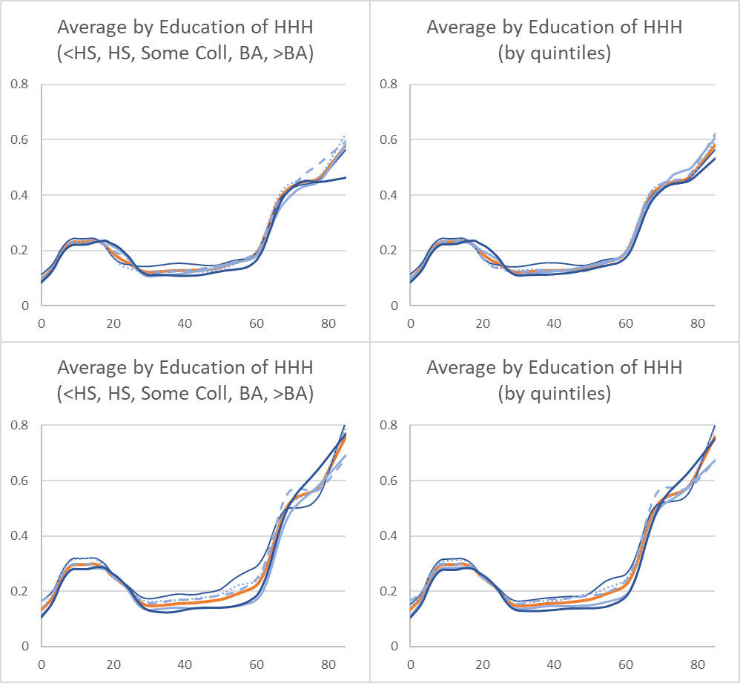
Government inflows by educ and educ quintile for 1988 and 2018
TGI by educ & educ quintile
1988
Benefits are greater for both children and elderly in 2018.
Education differences are smaller by quintiles.
Education differences in benefits received are generally greater in 2018.
Lowest education receive greater benefits during working years.
Lowest receive more public education also, perhaps because higher educ parents put kids in private schools (?).
2018

Slide 10
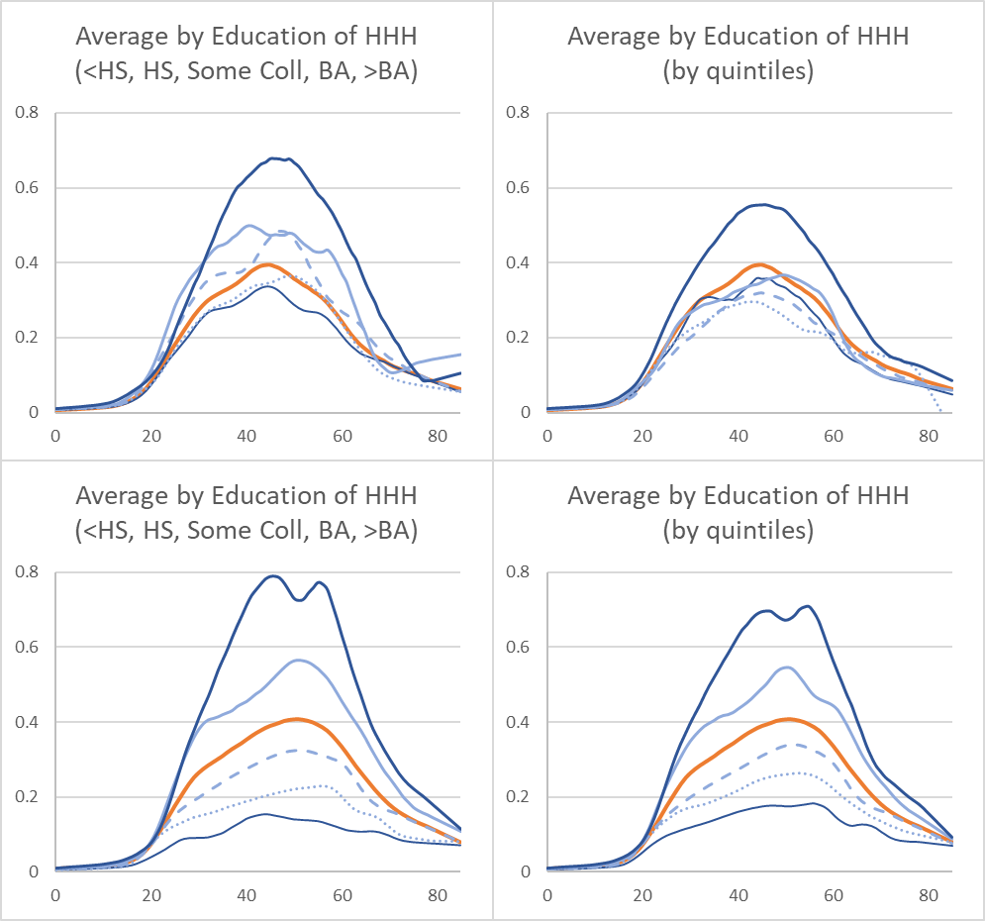
Taxes by educ & educ quintile
1988
Amazingly, taxation seems to become more unequal to the advantage of the lower education groups.
The changes are smaller when we look at them by quintile of education, but they remain strong.
I don’t understand, because I thought our tax system had become less progressive, not more.
2018

Slide 11
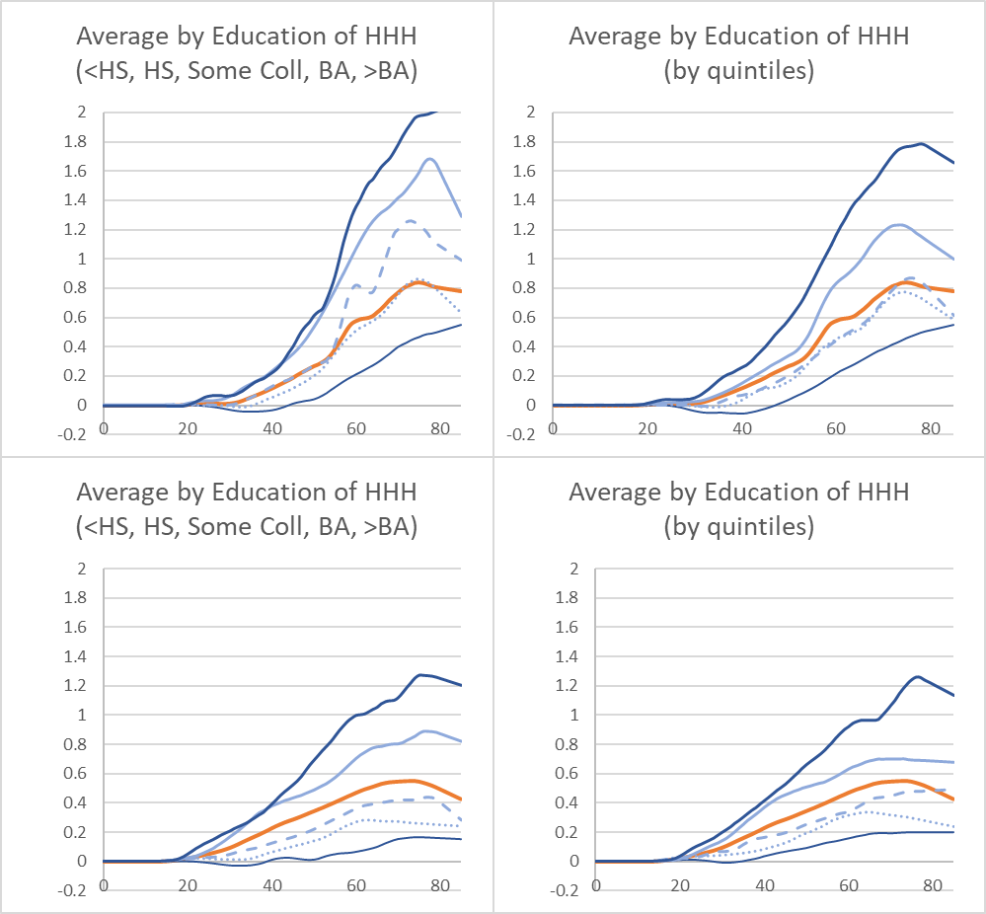
Asset income is much less at all education levels in 2018.
Asset Income by educ & educ quintile
1988
Why?
Recession?
Lower saving rates?
Low interest rates?
Very strange.
Asset income is very unequal by both measures.
2018

Slide 12
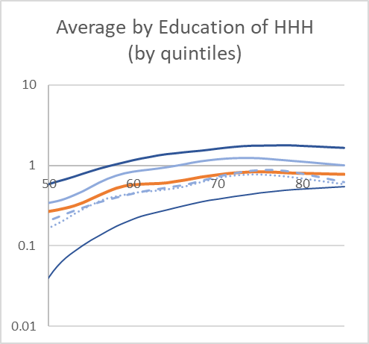
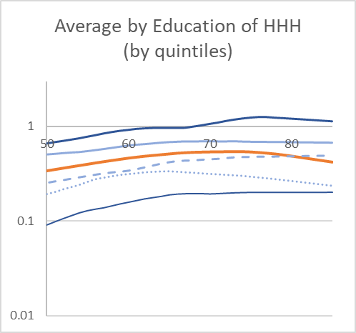
Tim and Nicole method assumes shape of age profiles same for 10% and 90%. Test this. Private asset income in 2018, ages 50-85, by education quintiles (log₁₀ scale)
1988
Log scale shows whether parallel with same shape (can’t show below age 50 because neg values).
Assumption is pretty good for asset income in 2018 above age 50, but not below (where lowest <0).
Lines are quite parallel, except for second quintile.
Less good for 1988. Bottom quintile converges after age 50.
In future we will do for top 10% and lower 90% of income distribution.
Private asset income
2018

Slide 13
Where we want to go
Distributions of individual NTA consumption, reflecting public and private transfers. Compare to distributions of individual primary incomes. Levels, trends.
Distributions of wealth including transfer wealth, comparison to distributions without transfer wealth. Trends, comparison to levels and trends of inequality in bequeathable wealth, Piketty, Saez, Zucman.

